Slide 2
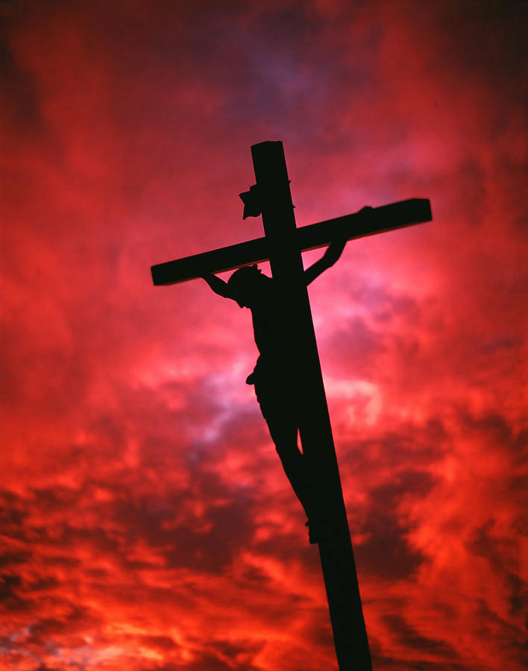
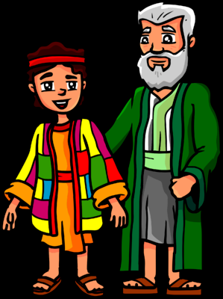
Joseph A Type Of Christ
Genesis 37:13-28

Slide 3
SEVEN WAYS JOSEPH AND CHRIST ARE ALIKE
1. Despised By His Brothers-
Genesis 37:4 “they hated him..”
John 1:11 “His own did not receive Him.”
Isaiah 53:3 “Despised and rejected by men”
Like Joseph, Jesus was DIFFERENT from them, and they could NOT STAND ANYONE who was not JUST LIKE THEM!

Slide 4
SEVEN WAYS JOSEPH AND CHRIST ARE ALIKE
2. Sold Him-
Genesis 37:27 “let us sell him…”
Matthew 26:14-16 “What are you willing to give me if I deliver Him to you?"
30 pieces of silver in payment for Christ
Every time we betray Christ for earthly achievement/ almighty dollar, we are no better than Judas!

Slide 5
SEVEN WAYS JOSEPH AND CHRIST ARE ALIKE
3. Great Love Shown-
Genesis 42:24 “turned himself away from them and wept…”
John 15:13 “Greater love has no one than this, to lay down one’s life for his friends”
Romans 5:6-9 “due time Christ died for the ungodly”
He DIED that WE might be SAVED!

Slide 6
SEVEN WAYS JOSEPH AND CHRIST ARE ALIKE
4. Preserving Life-
Genesis 45:5-7 “God sent me before you to preserve life…”
Matthew 1:21 “save His people from their sins..”
John 6:67,68 “You have the words of eternal life…”
EVEN for those who WANTED HIM DEAD!

Slide 7
SEVEN WAYS JOSEPH AND CHRIST ARE ALIKE
5. Found Alive-
Genesis 45:3 “I am Joseph; does my father still live?…”
Luke 24:46 “rise from the dead the third day”
Mark 16:6 “HE IS RISEN!”
The Empty Tomb was the Best Evidence of His Resurrection!

Slide 8
SEVEN WAYS JOSEPH AND CHRIST ARE ALIKE
7. Pardoned His Brethren-
Genesis 45:15 “by a great deliverance…”
Acts 2:38 “for the remission of sins…”
Acts 22:16 “Arise and be baptized, and wash away your sins…”
Mark 16:16 “He who believes and is baptized will be saved…”
Revelation 2:10 “Be faithful unto death….”

Slide 9
How Do You Measure Up To Our Royal Brother?

